Slide 1
Introduction to SU²
The open-source CFD code
July 1st, 2014
Francisco Palacios, Michael Colonno,
Thomas D. Economon, Juan J. Alonso
Department of Aeronautics & Astronautics
Stanford University

Slide 2
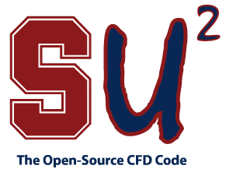
Introduction
Why SU²?
Supersonic Aircraft design
Unsteady design
Verification and Validation
Conclusions

Slide 3
Introduction
Why SU²?
Supersonic Aircraft design
Unsteady design
Verification and Validation
Conclusions

Slide 4
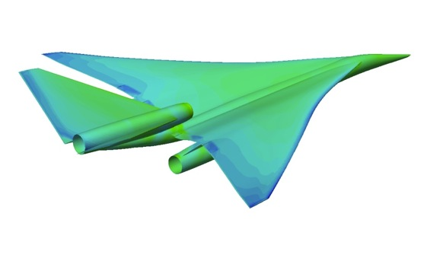
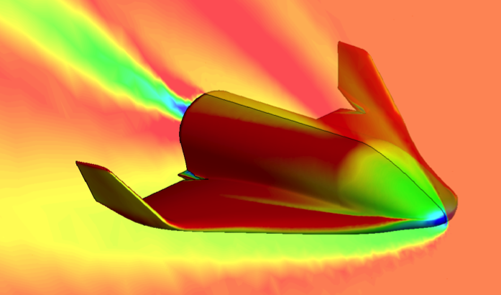
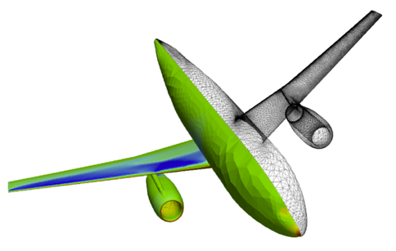
Optimal Shape Design
Introduction Our objective
Computational analysis tools have revolutionized the way we design aerospace systems.
Unfortunately, most established codes are close, proprietary, unavailable for some potential users, or prohibitively expensive.
The SU² team looks forward to making CFD analysis and design freely available as open-source software, involving everyone in its creation, enhancement, and rapid development.
NASA N+2 Supersonics Program (2013)
SOAR - S3 Swiss Space Systems (2014)

Slide 5
Optimal Shape Design
Introduction Aerospace Design Lab @ Stanford Univ. Aero & Astro
Our lab has a long tradition of creating numerical tools for the analysis and design/optimization of problems governed by the equations of fluid flow. We are interested in:
Complex configurations of industrial interest.
Multi-disciplinary optimization problems.
Numerical methods in CFD.
In university laboratory we are also very concerned about minimizing the required effort to add new capabilities.
We fully endorse the spirit of the open-source movement: we are happy to support the efforts in the community adding capabilities that we would not have the chance/time/resources to add ourselves. Everyone benefits in this way.

Slide 6
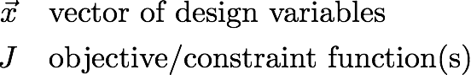
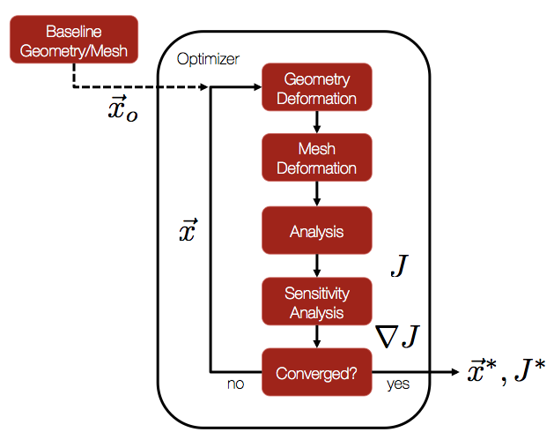
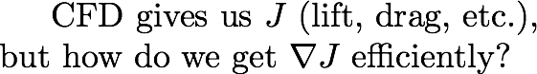
Optimal Shape Design
Introduction Optimal shape design
Optimal Shape Design (OSD) is concerned with finding the optimal shape for an object or surface that improves its performance
In aeronautics, aerodynamic performance typically depends on the shape of the vehicle or body, in complex and often difficult to predict ways
Adjoint gradient-based optimization:
Continuous adjoint methodology to achieve cost-independence wrt number of design parameters
Analytic expression for the gradient as a surface integral.
No memory or time overhead compared with the direct solver.

Slide 7
The Adjoint Approach
Introduction Objective of this talk
Mature design tools are not always available for novel engineering concepts.
There is a well-established “basic” theory and it is time to face complex novel concepts: do we have sufficiently mature design tools?
The objective of this talk is to introduce SU² and show an overview of challenges and opportunities for analysis and shape design methodologies.

Slide 8
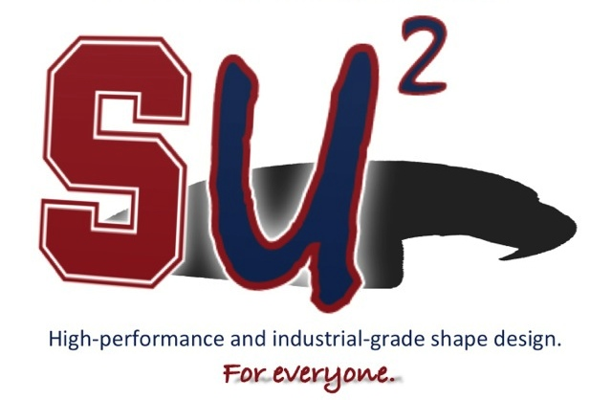
Introduction
Why SU²?
Supersonic Aircraft Design
Unsteady design
Verification and Validation
Conclusions

Slide 9

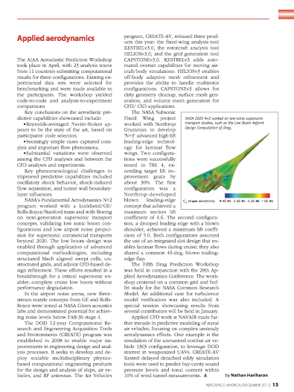
Introduction Computational tool: SU² suite
The SU² suite is an open-source collection of C++ based software tools to perform PDE analysis and solve PDE-constrained optimization problems.
SU² is under active development at Stanford University in the Aerospace Design Lab (ADL) of the Department of Aeronautics and Astronautics.
Web page with more than 90,000 visits (34% Europe, 30% USA, 11% China, 6% India, 19% others), more than 10,000 downloads since 2012.
http://su2.stanford.edu/
2012 SU² team, "Stanford University Unstructured (SU2): An open-source integrated computational environment for multi-physics simulation and design", AIAA Paper 2013-0287.
2013 SU² team, "Stanford University Unstructured (SU2): Open-source analysis and design technology for turbulent flows", AIAA Paper 2014-0243.

Slide 10
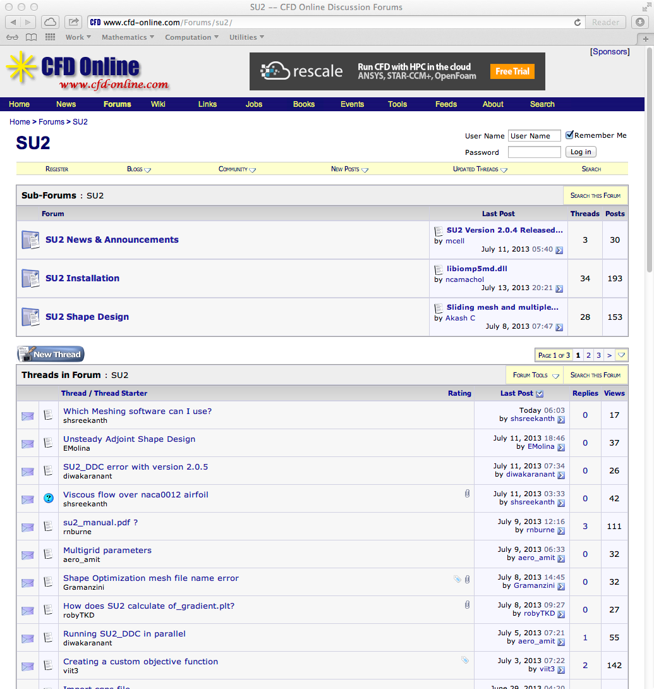
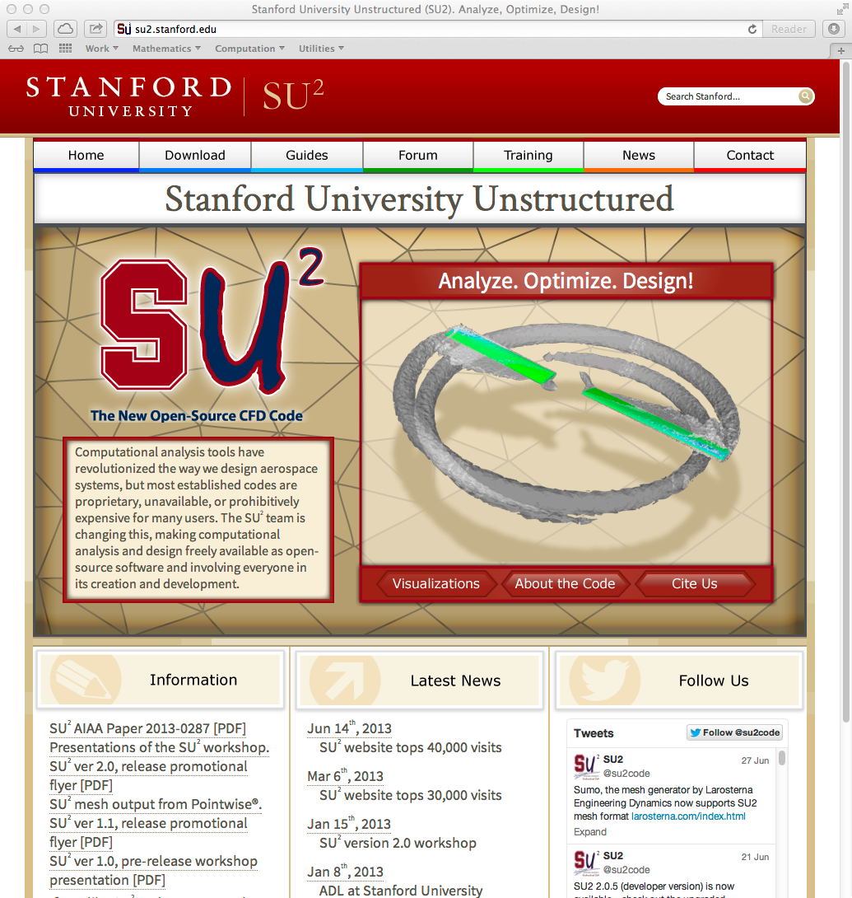
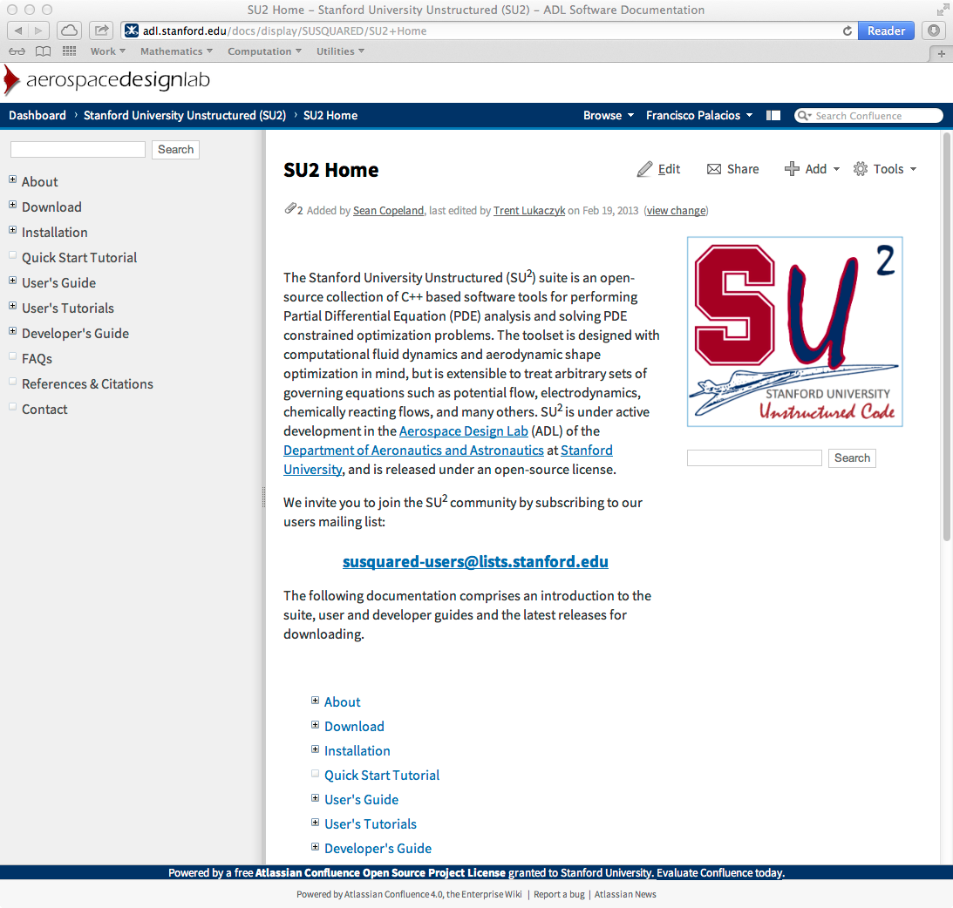
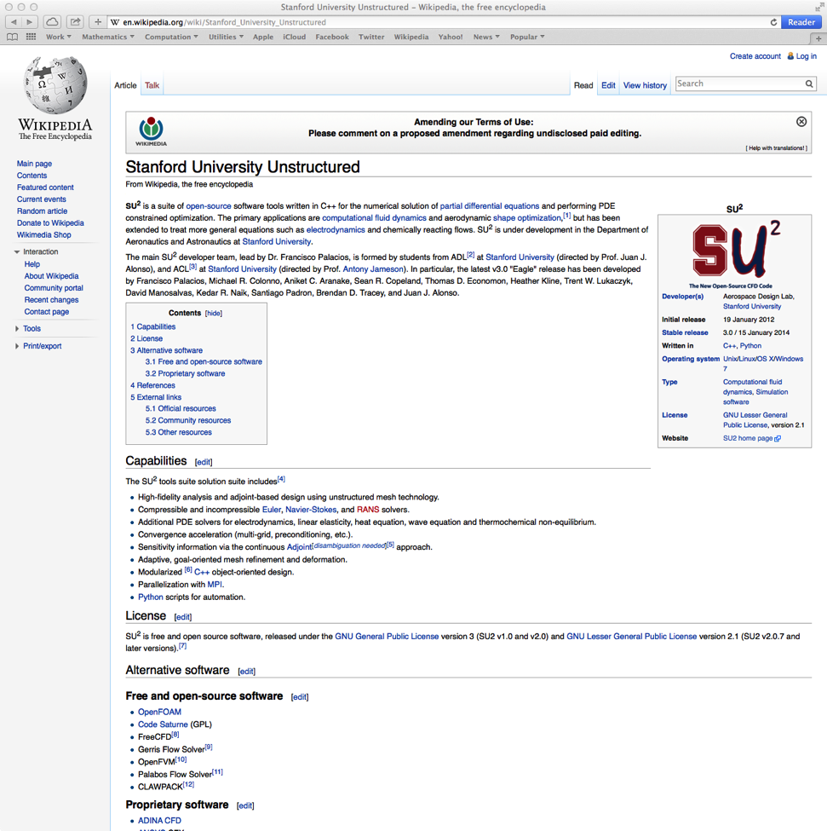
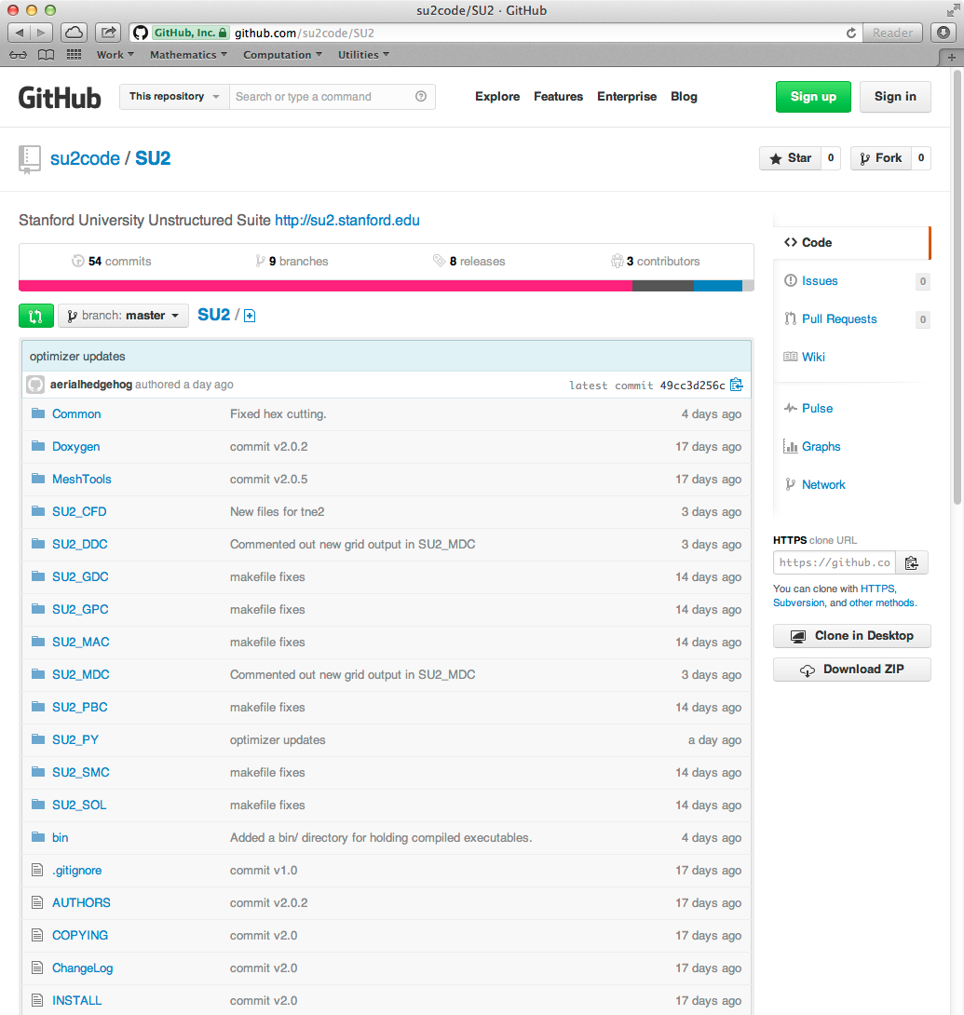
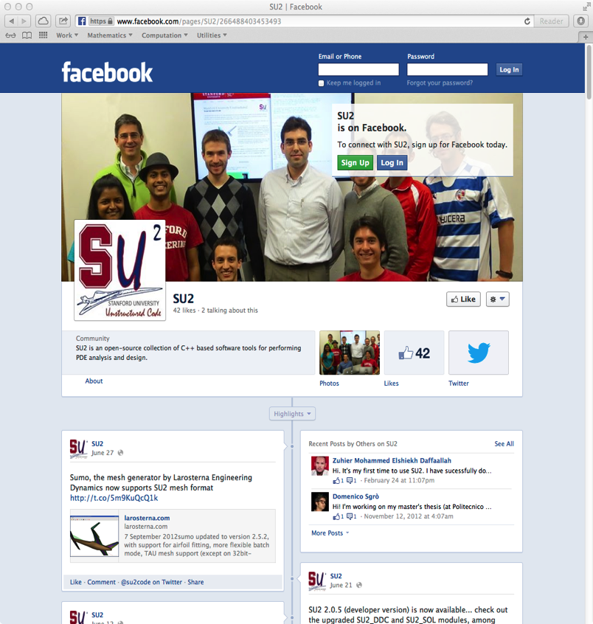
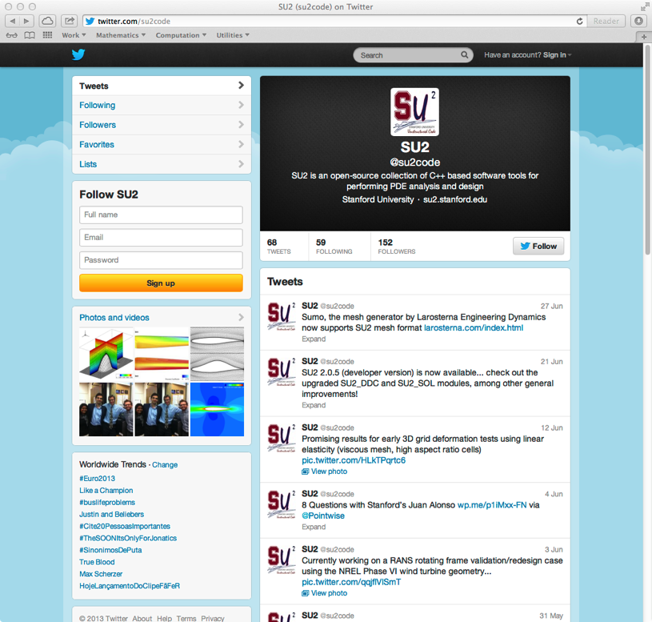
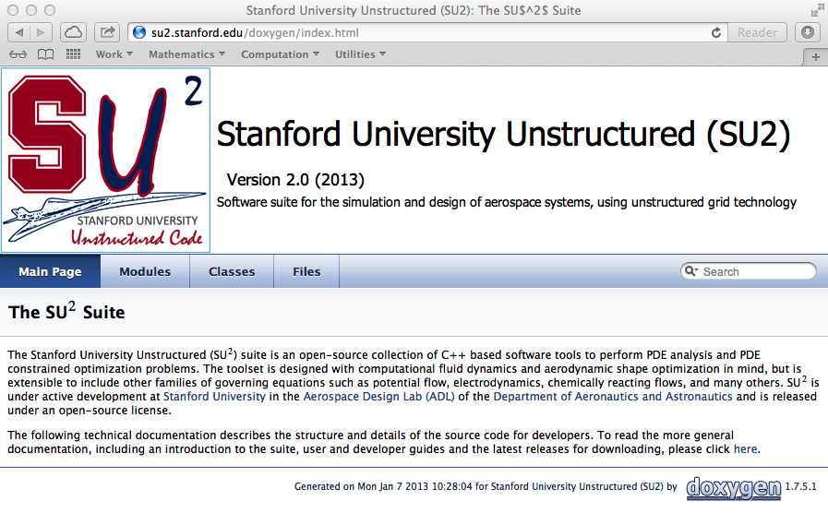
Introduction Open source concept

Slide 11

Optimal Shape Design
Why SU²? Software integration in aerodynamic shape design
Integrating existing software packages into coupled multi-physics analysis and design optimization solvers is a challenge.
The variety of approaches chosen for the independent components of the overall problem make it difficult to:
Expand the range of applicability to situations not originally envisioned.
Reduce the overall burden of creating integrated applications.
Exploit fully-coupled approaches.

Slide 12
Optimal Shape Design
Why SU²? Lasting infrastructure for future efforts
An open-source model: basic formulation with a reasonable set of initial capabilities. We would like to see contributions from the community!
Portability: SU² has been developed using ANSI C++ and only relies on widely-available, well-supported, open-source software.
Reusability and encapsulation: SU² is built so that the main concepts (geometry, sol. algorithms, num. algorithms, etc) are abstracted to a very high-level. This abstraction promotes reusability of the code and enables modifications without adversely affecting other portions of the suite.
Flexibility: required to re-purpose existing software for new and different uses. Enabling a common interface for all the necessary components.
Performance: we have attempted to develop numerical solution algorithms that result in high-performance convergence of the solver in SU². Striving to strike balance between performance and flexibility.
Gradient availability: for many applications it is important to obtain sensitivities of the responses computed by SU² to variations in design parameters.

Slide 13
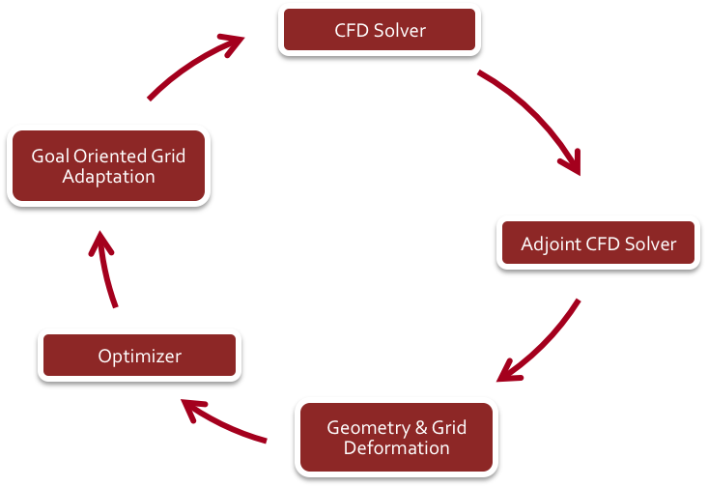
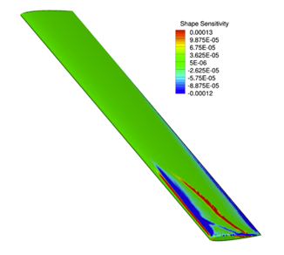
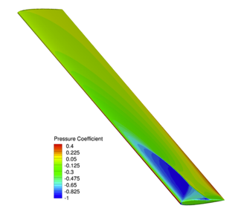
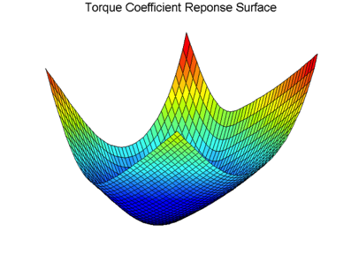
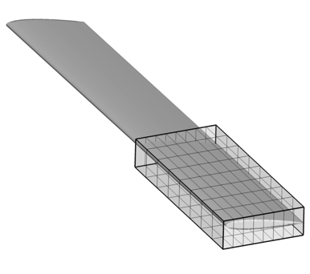
Optimal Shape Design
Why SU²? Multi-physics shape optimization
Shape Optimization
Self-contained optimization env.
Gradient computation using adjoint approach.
3D design variable definition and built-in geometry and mesh deformation.
Torque Sensitivity to Shape Deformations
Pressure Coefficient
Torque Coefficient Response Surface
Multi-Physics Simulations
Simultaneous analysis of different equation sets with tight coupling.
Free surface simulations, noise, fluid structure, etc.
Multi-species plasma solver for simulating ionized flows.

Slide 14
Optimal Shape Design
Why SU²? Easy to adapt
1a) Read Input
Class: CConfig
Read the config file.
1b) Read Mesh
Class: CGeometry
Read the mesh file.
Set up multigrid meshes.
2) Solve Equations
Class: CSolution
Euler Equations: CEulerSolution
Plasma Equations: CPlasmaSolution
Euler Adj. Eq.: CEulerAdjSolution
Heat Equations: CHeatSolution
And others…
3) Write Output
Class: COutput
Print on screen
Write solution file
Write restart file
Write history file
Store Flow Variables
Class: CVariable
Stores variables at every mesh node.
Declare & store all flow variables
CEulerVariable: Density, energy etc.
CNSVariable: CEulerVariable + Viscosity
CAdjVariable: Adjoint variables
And others…
Discretization
Class: CNumerics
Spatial Discretization
Convective Flux, Jacobian
CNumerics:: Roe/JST/etc.
Viscous Flux, Jacobian
CNumerics:: Avg_Grad/etc.
Source Terms, Jacobian
CNumerics:: PieceWiseConst.
Temporal Discretization
Implicit Time Integration
Explicit Euler/ Runge-Kutta
Dual Time
Solve Linear System
Class: CSparseMatrix
Linear solvers
BiCSTAB
GMRES
Preconditioners
Linelet
LU-SGS
Low Mach number
Update solution vector

Slide 15
Optimal Shape Design
Why SU²? Verification and Validation
Verification and Validation is critical. It should address the consistency of the numerical methods, a solid accuracy assessment for different critical application cases, and sensitivity studies with respect to parameters.
Unit/Test problems: zero pressure gradient flat plate boundary layer, bump in a channel, and unsteady flow around a square cylinder.
Subsonic airfoil geometries: NACA 0012 with attached flow, NACA 4412 with a recirculation bubble, and the McDonnell-Douglas 30P30N three-element high-lift configuration.
Subsonic wing and rotorcraft configurations: delta wing at a high angle of attack, and the Caradonna & Tung rotor.
Transonic airfoil geometries: NACA 0012 with attached flow after a shock, RAE 2822 with flow separation.
Transonic wing and full aircraft configurations: ONERA M6, and the DLR F6 model.
2013 SU² team, "Stanford University Unstructured (SU2): Open-source analysis and design technology for turbulent flows", AIAA Paper 2014-0243.

Slide 16
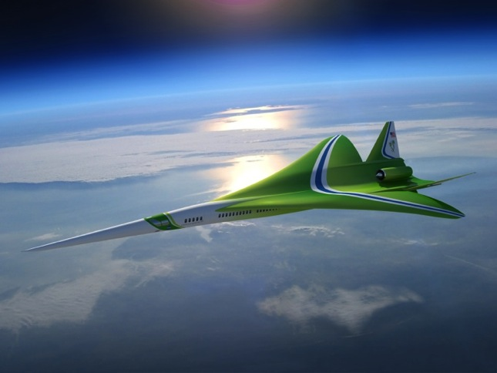
Introduction
Why SU²?
Supersonic aircraft design
Unsteady design
Verification and Validation
Conclusions
Image | Lockheed Martin

Slide 17
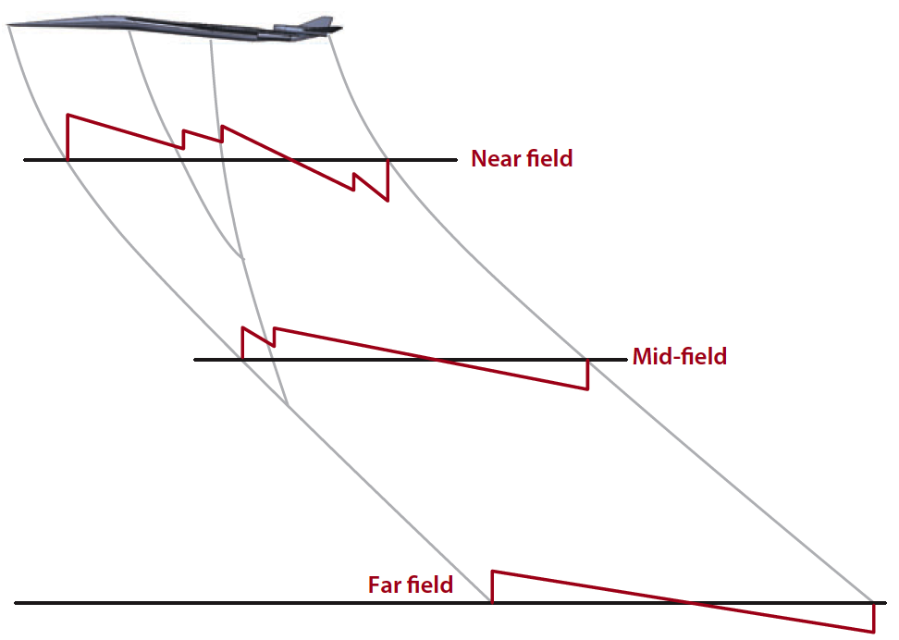
Supersonic aircraft design Straight forward design
Our ability to fly at supersonic speeds over land in civil aircraft depends on our ability to reduce the perceived loudness of the sonic boom
Aerodynamic shape optimization.
Solve Euler/RANS adjoint problem in complex geometries.
Inverse design problem (wave propagation).
Given a pressure signature on the ground, compute the near-field pressure.
Coupling.
Optimization algorithm.
Gradient based, surrogated model, etc.
Definition of the design variables
CAD based design variables, Free-Form Deformation, etc.
Definition of the objective function and constraints.
Minimization of perceived noise, etc.
Aerodynamic, geometric, and stability constraints.
Image | Multidisciplinary optimization with applications to sonic-boom minimization by J. J. Alonso and M. R. Colonno

Slide 18
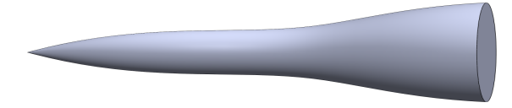
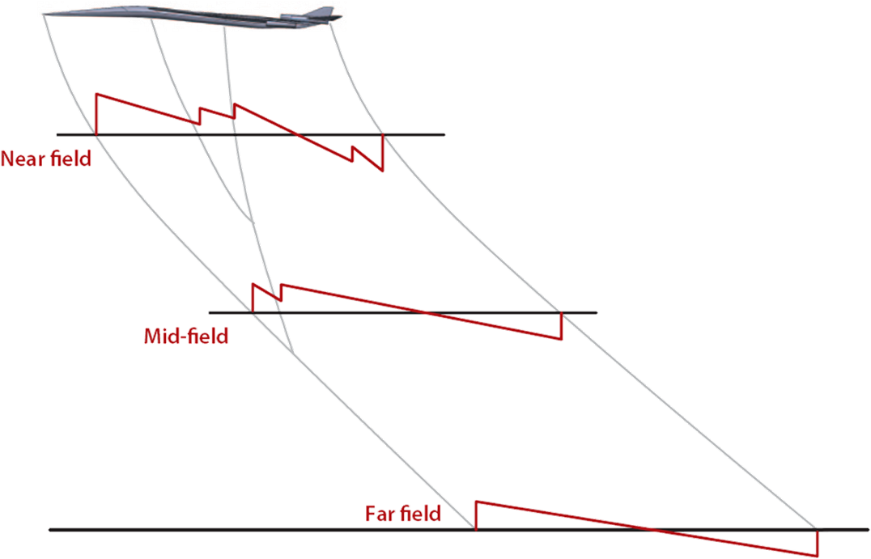
Supersonic aircraft design Equivalent Area design approach
Image | Multidisciplinary optimization with applications to sonic-boom minimization by J. J. Alonso and M. R. Colonno

Slide 19
Supersonic aircraft design Equivalent Area objective function
The Equiv. Area at a particular location and azimuthal angle is given by
where
We are interested in the L-2 norm of the difference between the calculated equiv. area and a target at different azimuthal angles:
Can we handle this kind of objective function using the standard continuous adjoint formulation? Yes!
F. Palacios, J. J. Alonso, M. Colonno, J. Hicken, and T. Lukaczyk “Adjoint-Based method for supersonic aircraft design using equivalent area distribution”, AIAA Paper 2012-0269
T. Lukaczyk, F. Palacios, and J. J. Alonso, “Response Surface Methodologies for Low-Boom Supersonic Aircraft Design using Equivalent Area Distributions”, AIAA Paper 2012-5705

Slide 20
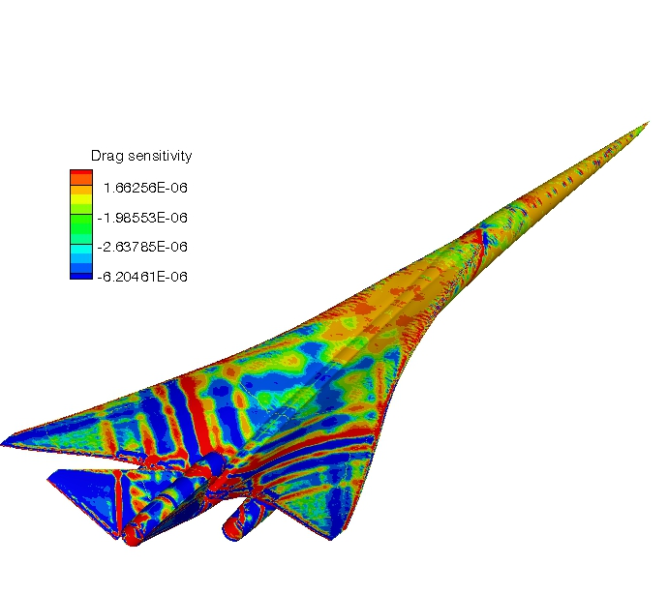
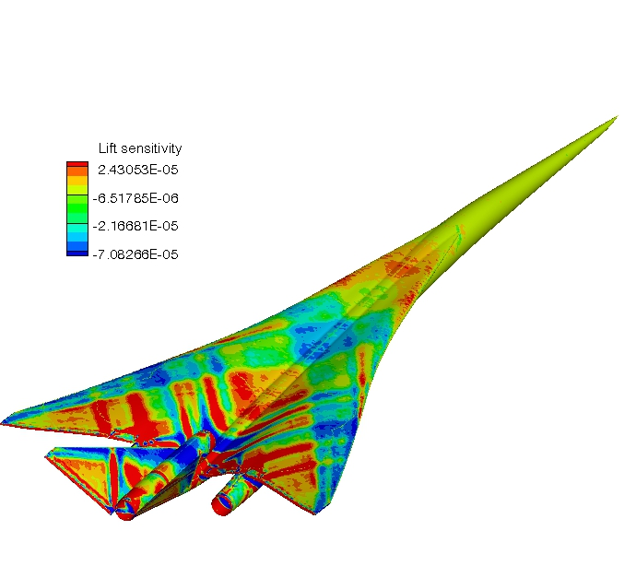
Supersonic aircraft design Surface drag and lift sensitivities using the adjoint method
Magnitude of surface sensitivity represents changes in cost function caused by changes in geometry.
Drag sensitivity (Mach 1.6, AoA 2.3deg)
Lift sensitivity (Mach 1.6, AoA 2.3deg)
Designers can use this sensitivity information to determine appropriate parameterizations of the configuration prior to optimization.

Slide 21
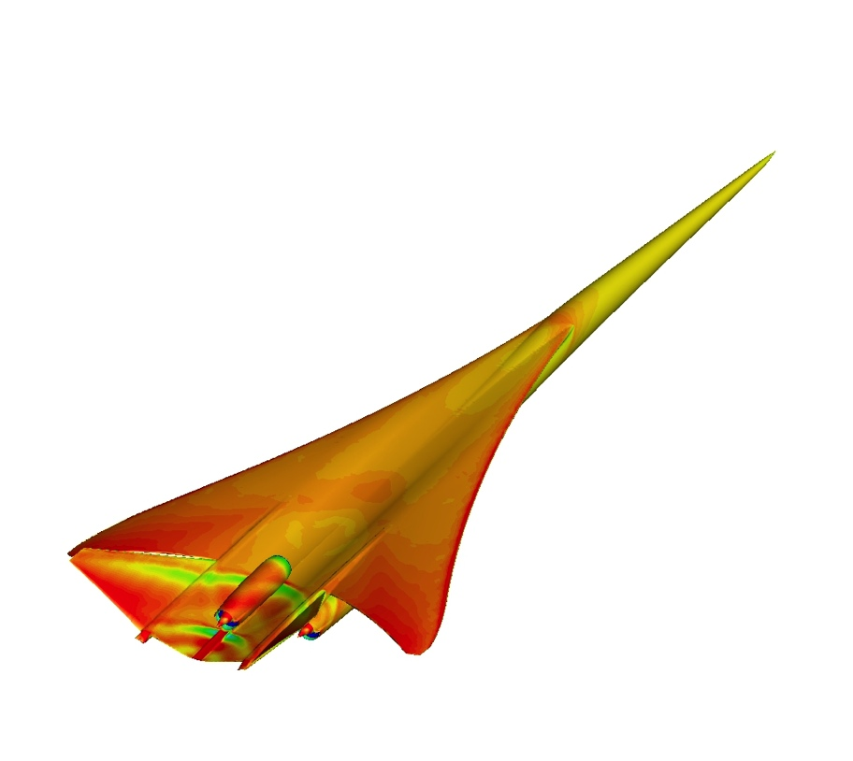
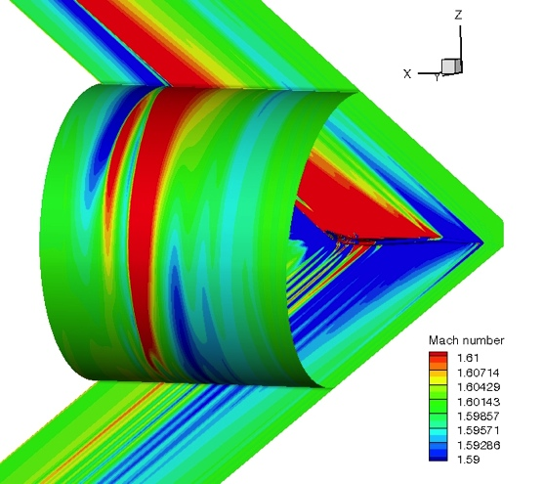
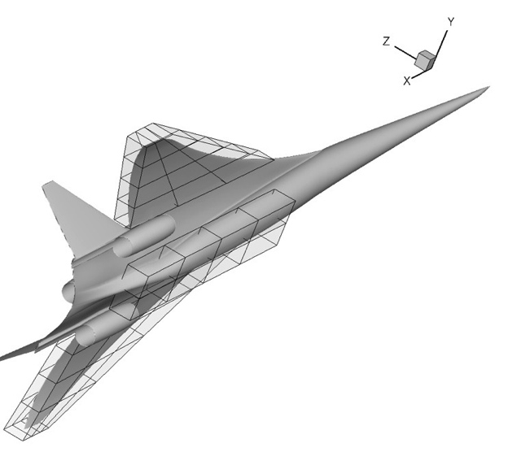
Supersonic aircraft design Recovering 1044-1 A_{e} starting from 1044-3b
It is possible to recover the boom performance after including structurally-motivated and engine modifications to the baseline aerodynamic shape?
Original 1044-3b configuration with structurally-motivated modifications
Equivalent area computation at different azimuthal angles
?
Comparison with baseline 1044-1 configuration without structurally-motivated modifications
Optimization to
Recover Equivalent Area with C_{L} (and possibly C_{D}) constraint.

Slide 22
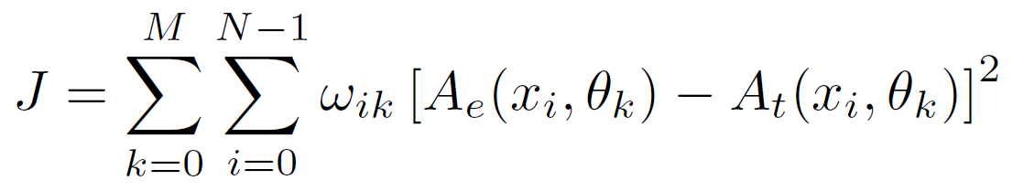
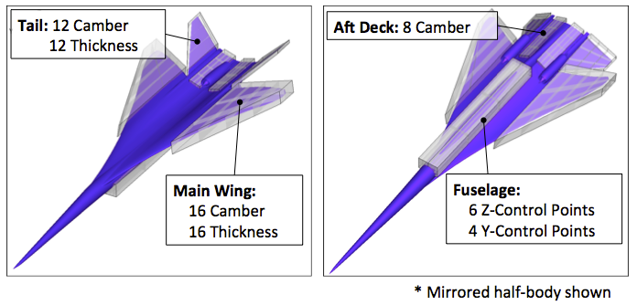
Supersonic aircraft design Optimization problem description
Min.
s.t.
J(x)
x ϵ R^{N}
C_{L}(x) > 0.136
Ma = 1.7, AoA = 2.1deg, H = 50,000 ft
Recover 1044-1 target equivalent area distribution
Near-field at 2 body lengths
Maintain minimum lift
Free-Form Deformation (FFD) design variables
Multiple azimuth formulation maintains off-track performance
Azimuth angle ranges: 0⁰ to 60⁰, 2⁰ increments

Slide 23
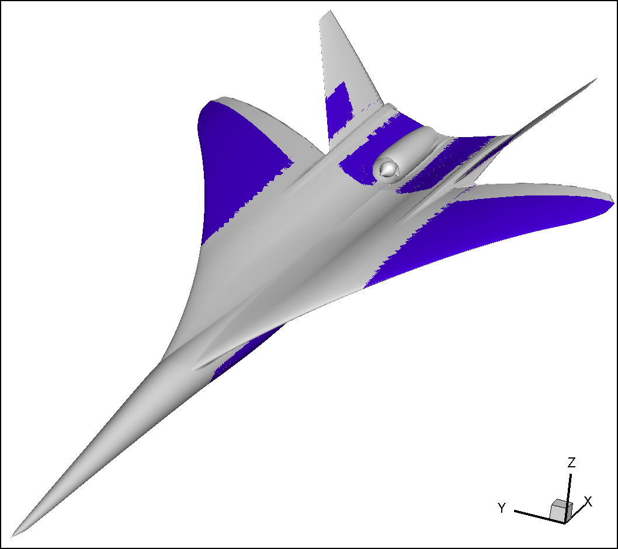
Supersonic aircraft design Baseline and optimized shape
85.5% Reduction in Equivalent Area Objective
+1.8% C_{L}, +1.1% C_{D}
Drag may be minimized by a second optimization with Ae and C_{L} constraints or an optimization with multiple constraints
Baseline
Optimized
Main wing dihedral increased, trailing edge de-cambered
Tail angle of attack increased near root
Fuselage volume increased

Slide 24
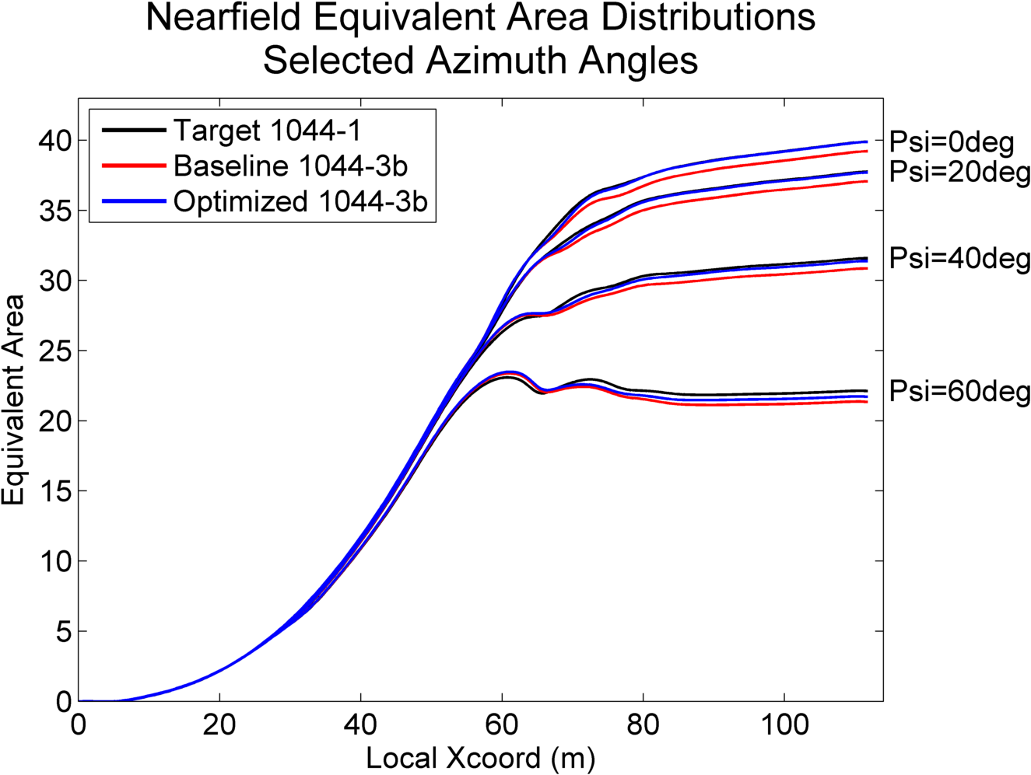
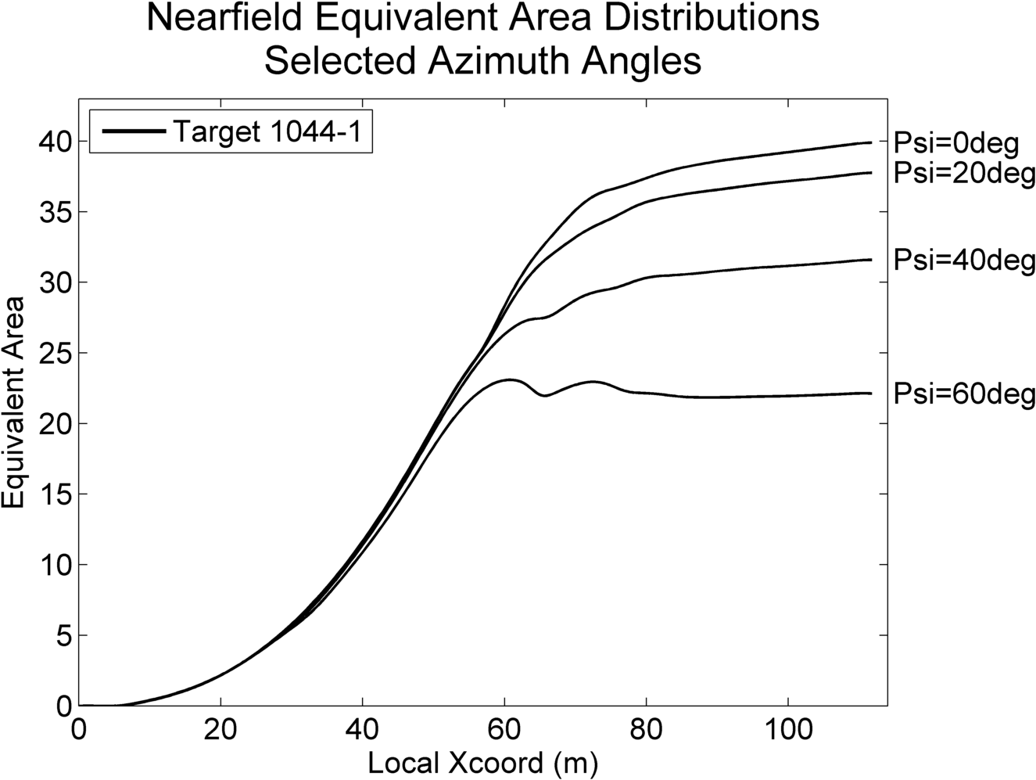
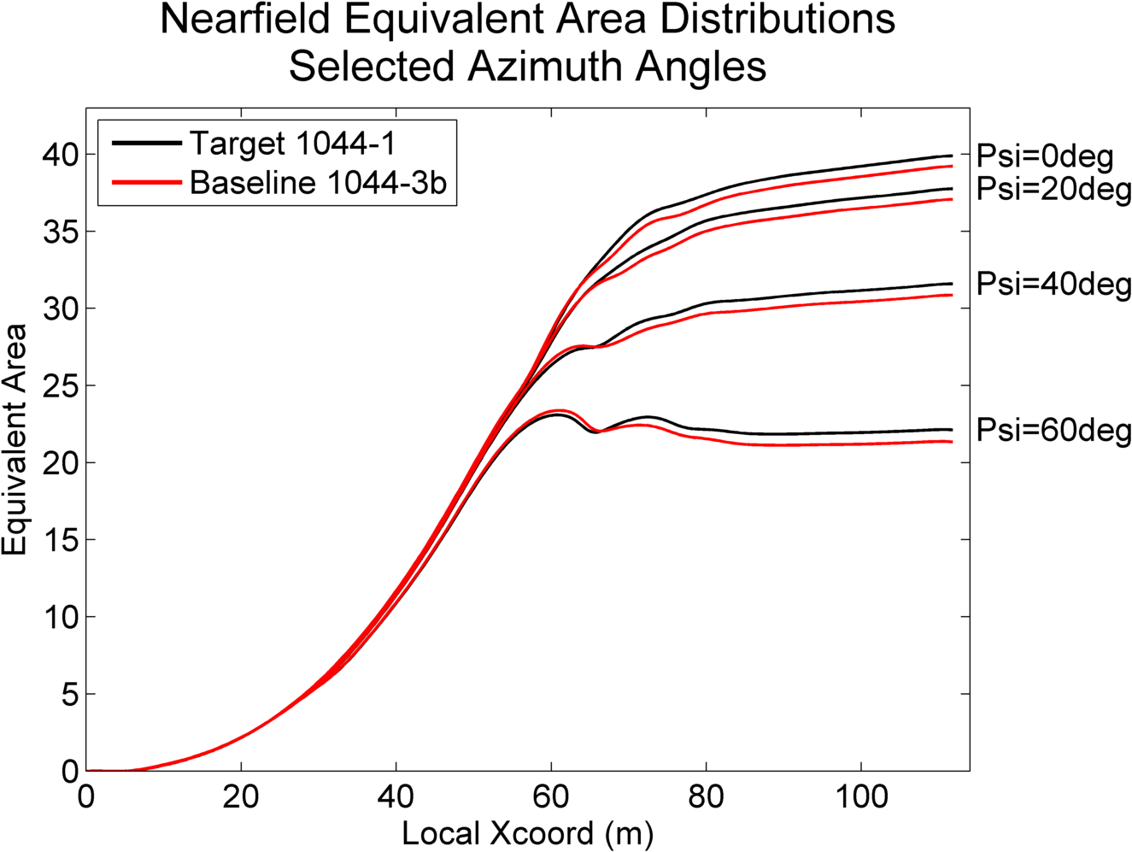
Supersonic aircraft design Equivalent area distribution comparison

Slide 25
Supersonic aircraft design Comparison of ground boom signatures
Phi = 0 deg
Phi = 30 deg
Phi = 50 deg

Slide 26
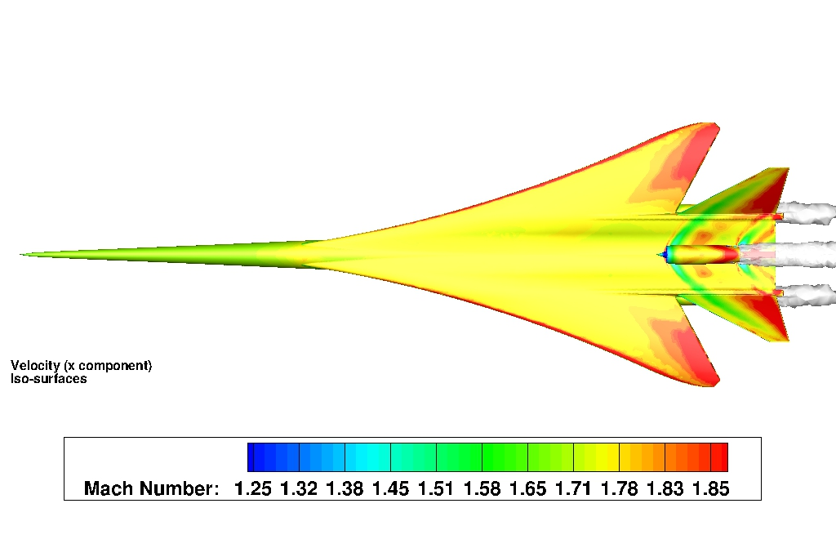
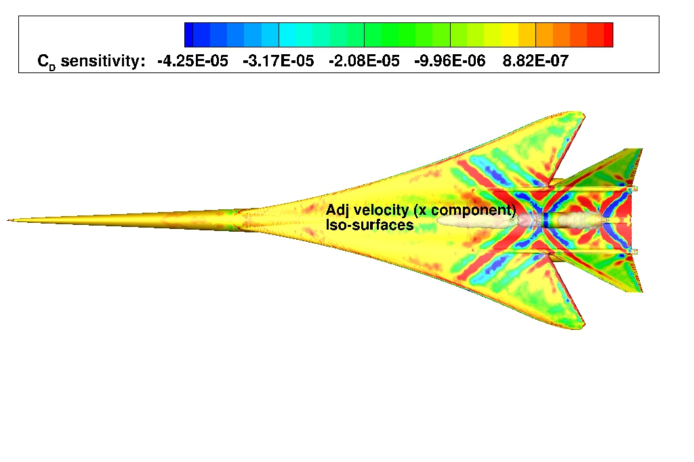
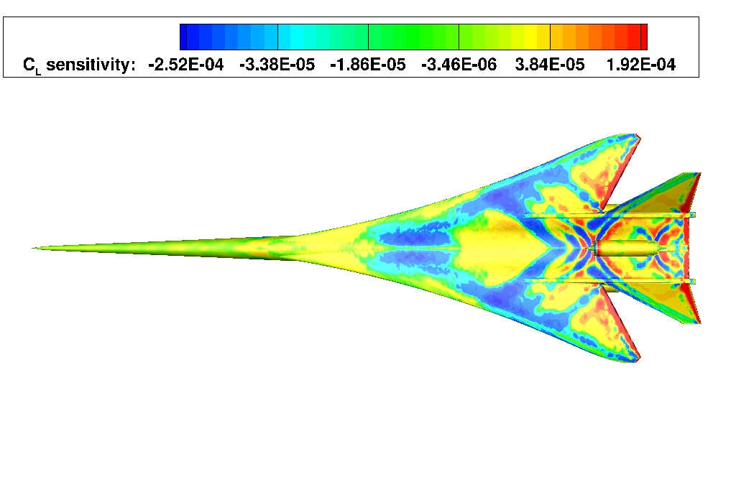
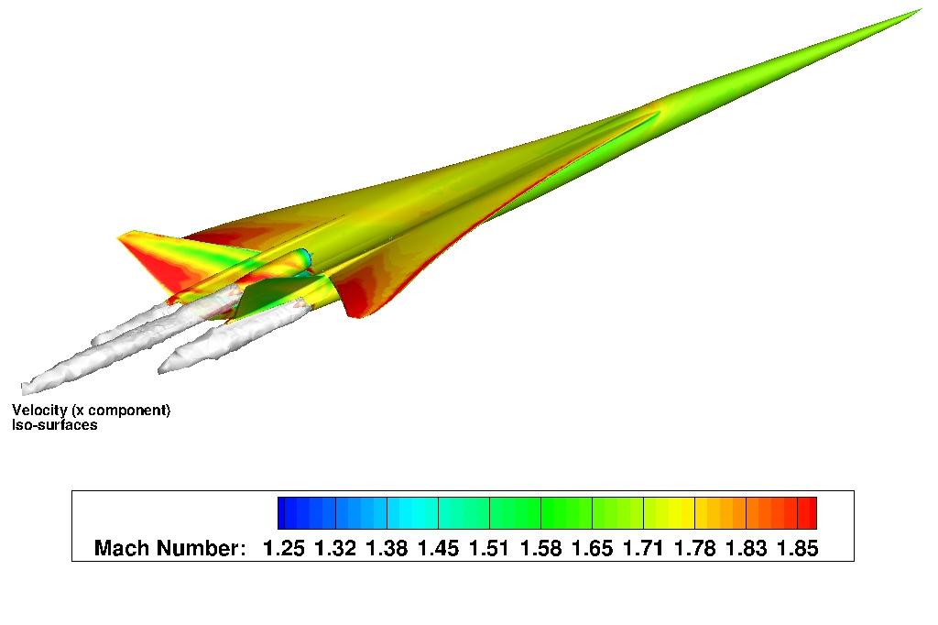
Direct and Adjoint Simulations with Engines
MACH NUMBER= 1.7
AoA= 2.1
FREESTREAM PRESSURE= 11665.9 Pa
FREESTREAM TEMPERATURE= 216.65 K
DRAG OBJECTIVE FUNCTION
Fan face Mach 0.515
Total nozzle temp 569.7 K
Total nozzle pressure 109764.5 Pa
LIFT OBJECTIVE FUNCTION

Slide 27
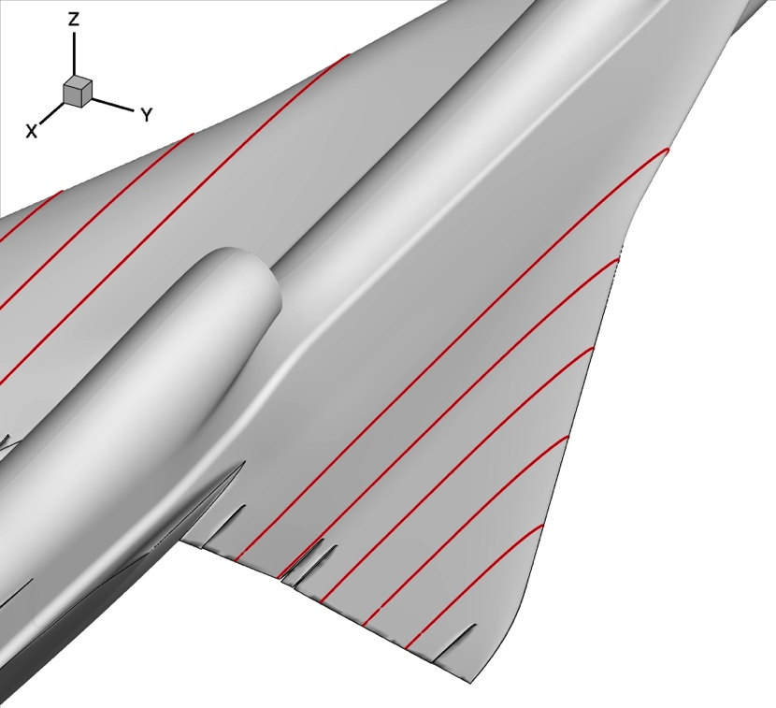
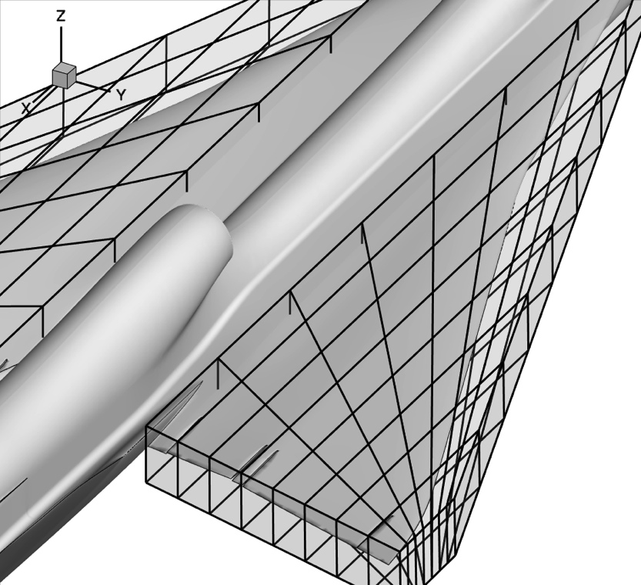
Trim (C_{M} = 0.0) and A_{e} Optimization
Min.
s.t.
C_{Ae}(x), x ϵ R^{N}, N=124,
C_{D}(x) < 0.0295
C_{L}(x) > 0.1062
C_{My}(x) > 0.0
t/c @ 2y/b = (0.1, 0.3, 0.5, 0.7, 0.9) @ x/c = (0.25, 0.5, 0.75) > 95% or 90% of baseline
LBFD configuration: C435
Euler simulation with propulsion effects
124 design variables (Free-Form Deformation)
3 flow-derived constraints (C_{D}, C_{L} and C_{My}) => 4 adjoint runs every design iteration
15 geometric constraints
Main challenge: trim the aircraft, reduce C_{D,} and maintain C_{L}, with minimal impact on the equivalent area

Slide 28
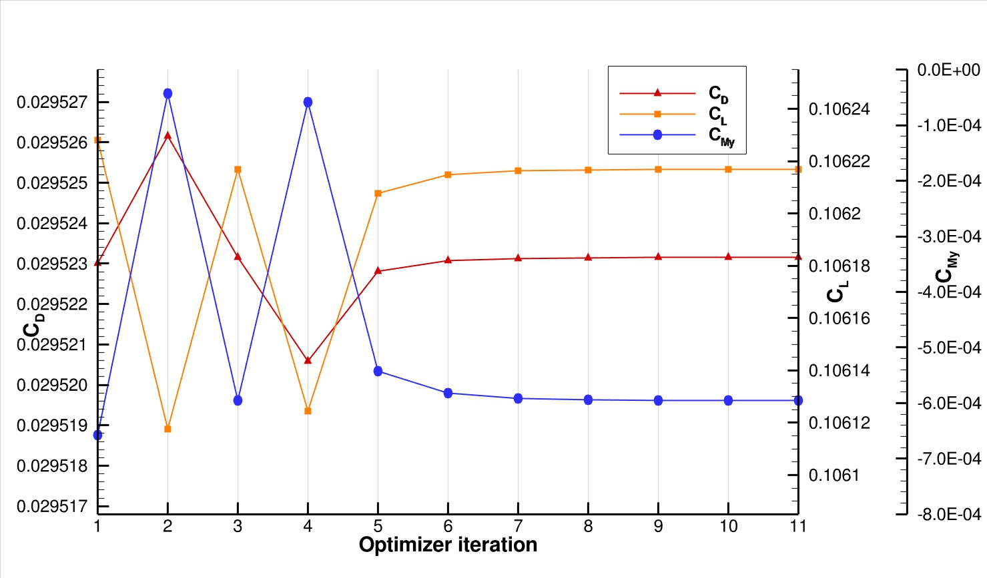
Optimization Using a “Direct” Approach
Min.
s.t.
C_{Ae}(x), x ϵ R^{N}, N=124,
C_{D}(x) < 0.0295
C_{L}(x) > 0.1062
C_{My}(x) > 0.0
t/c @ 2y/b = (0.1, 0.3, 0.5, 0.7, 0.9) @ x/c = (0.25, 0.5, 0.75) > 90% of baseline
After 10 iterations no significant improvement in the objective function or C_{My}

Slide 29
Optimization using an “Indirect” approach
1st step) Increase C_{M} (positive value).
Max.
s.t.
C_{My}(x), x ϵ R^{N}, N=124,
C_{L}(x) > 0.1062
t/c @ 2y/b = (0.1, 0.3, 0.5, 0.7, 0.9) @ x/c = (0.25, 0.5, 0.75) > 90% of baseline
2st step) Minimize C_{D} with constraints.
Min.
s.t.
C_{D}(x), x ϵ R^{N}, N=124,
C_{L}(x) > 0.1062
C_{My}(x) > 0.0
t/c @ 2y/b = (0.1, 0.3, 0.5, 0.7, 0.9) @ x/c = (0.25, 0.5, 0.75) > 90% of baseline
3st step) Minimize C_{Ae} with constraints.
Min.
s.t.
C_{Ae}(x), x ϵ R^{N}, N=124,
C_{D}(x) < 0.0295
C_{L}(x) > 0.1062
C_{My}(x) > 0.0
t/c @ 2y/b = (0.1, 0.3, 0.5, 0.7, 0.9) @ x/c = (0.25, 0.5, 0.75) > 90% of baseline

Slide 30
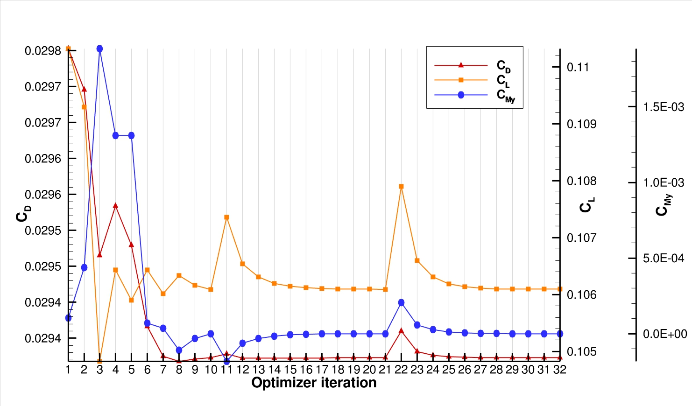
2st step) Minimize C_{D} with Constraints
Including pitching, lift and geometric constraints

Slide 31
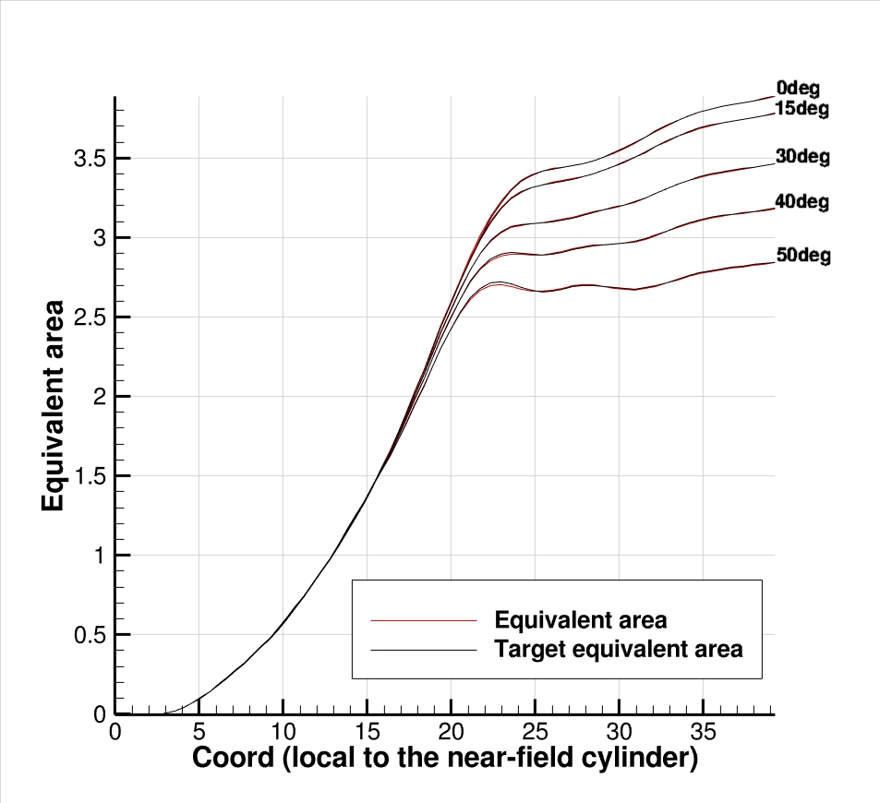
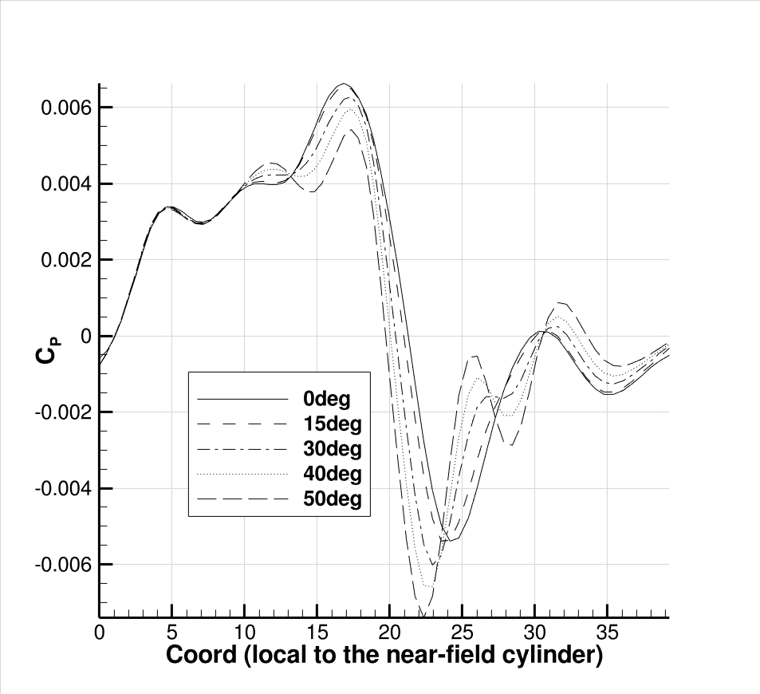
3st step) Minimize C_{Ae} with Constraints
Final design recovers the original target equivalent area
Final result: C_{M}=0.0 maintaining C_{D}, C_{L} and equivalent area.

Slide 32
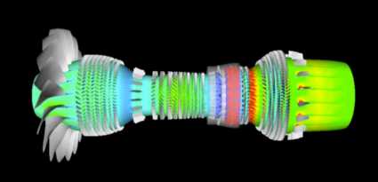
Introduction
Why SU²?
Supersonic aircraft design
Unsteady design
Verification and Validation
Conclusions
Image | Stanford University

Slide 33
Design in Unsteady Flows
Unsteady aerodynamic shape design Introduction
Challenges for unsteady design:
Computational cost can increase dramatically for time-accurate simulations
Need to manage large amounts of solution data (adjoint requires reverse time integration)
Handling moving surfaces / dynamic meshes in the formulation requires the Arbitrary Lagrangian-Eulerian (ALE) form of the flow equations.
Due to the complexity of the unsteady design problem, a continuous adjoint approach is appealing due to…
Recovering a surface formulation for the gradient with no dependence on the volume mesh (use differential geometry)
Flexibility in numerical methods to help mitigate convergence issues for stiff problems
The time-accurate, continuous adjoint PDE can also be discretized for different problems immediately (rotating frame or time-spectral approaches for instance)

Slide 34
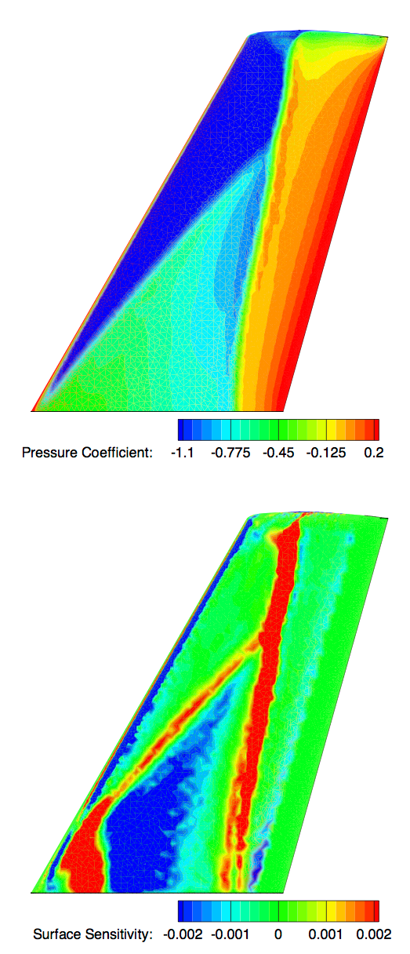
Surface Sensitivity
Unsteady aerodynamic shape design Shape sensitivity
Instantaneous Flow Solution
Key result of the continuous adjoint derivation
Measures change in the objective function w.r.t. small perturbations in the local normal direction
Computed at each surface mesh node at negligible cost from the flow and adjoint variables on the surface
Gradient expression is a surface integral: no dependence on the volume mesh
Offers physical insight and designer intuition
Instantaneous Sensitivity for a Drag Objective
T. D. Economon, F. Palacios, J. J. Alonso, "Optimal Shape Design for Open Rotor Blades," AIAA Paper 2012-3018
T. D. Economon, F. Palacios, J. J. Alonso, "Unsteady Aerodynamic Design on Unstructured Meshes with Sliding Interfaces," AIAA Paper 2013-0632
T. D. Economon, F. Palacios, J. J. Alonso, "A Viscous Continuous Adjoint Approach for the Design of Rotating Engineering Applications," AIAA Paper 2013-2580

Slide 35
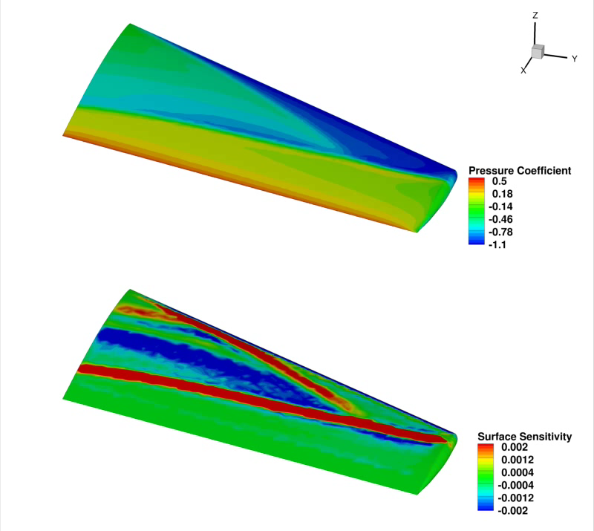
Pitching Wing
Unsteady aerodynamic shape design ONERA M6
Pitching wing in transonic flow:
Mach = 0.8395
Reduced frequency of 0.1682
Mean alpha of 3.06 degrees
Pitching amplitude of 2.5 degrees
Reynolds number = 11.72 million
Pitching about the y-axis through the root quarter-chord
25 time steps per period for 7 periods.
Unsteady RANS (S-A) equations on rigidly transforming meshes
Flow Solution
Surface Sensitivities for a Drag Objective

Slide 36




Pitching Wing
Unsteady aerodynamic shape design ONERA M6
25 upper surface control point variables
20.3 % Reduction in Time-averaged Drag

Slide 37

Pitching Wing
Unsteady aerodynamic shape design ONERA M6
RANS (S-A)
(incidence of max drag)

Slide 38
Introduction
Why SU²?
Supersonic aircraft design
Unsteady design
Verification and Validation
Conclusions

Slide 39





Verification and Validation High fidelity analysis (I/IV)
DLR F6

Slide 40


Verification and Validation High fidelity analysis (II/IV)
Discrepancy in slat C_{p} due to
the cut plane
NASA Trap Wing (config 1)
Slat 30 deg, Flap 25 deg
1st AIAA CFD High Lift Prediction Workshop
C_{p} distributions for the three elements from experiment as compared to SU². This is for
eta = 0.65 (65% span).

Slide 41



Verification and Validation High fidelity analysis (III/IV)
McDonnell-Douglas 30P30N three-element high-lift configuration

Slide 42





Verification and Validation High fidelity analysis (IV/IV)
Caradonna & Tung rotor

Slide 43
Introduction
Why SU²?
Supersonic Aircraft design
Unsteady design
V&V
Conclusions

Slide 44
Conclusions Optimal Shape Design
Aerodynamic Optimal Shape Design is a high-impact field with a need for sophisticated engineering, mathematical and computational developments.
We have completed a comprehensive V&V process for the RANS flow solver portion of the SU² software suite. SU² solutions are shown to be in excellent agreement with both the available experimental data and other numerical simulations.
Since the framework is tailor-made for coupled analyses, SU2 dramatically lowers the implementation barrier for tackling aeroelastic, aeroacoustic, and aerothermodynamic problems of critical interest to the aerospace community.
The release of the SU² under the GNU LGPL (v2.1) provides worldwide access to industry-standard analysis tools for tackling industrial-scale research problems.

Slide 45
Conclusions Ongoing Work
Recently selected as Intel Parallel Computing Center: SU2_PHI, improving performance and scalability while retaining flexibility. Porting to advanced Xeon and Phi architectures with high performance? Design in a box?
U. Braunschweig: improving turbulence models
Univ. of Aachen (Prof. Nico Gauger): automatic differentiation for steady and unsteady flow control
Delft University: real gas models
VKI: mutation++ library for non-eq flows and combustion
VSSC (India): Launch vehicle configurations
NASA: Integration with OpenMDAO, advanced propulsion architectures
Others: transition models, UAVs, learning CFD, etc.

Slide 46
Thanks a lot for your attention!
Questions & Answers
More details in http://su2.stanford.edu/

